Slide 1
DV1C04 Deployment and Monitoring in DevOps
L08
Configuration Management

Slide 2
Learning Objectives
Describe Configuration Management (CM)
Identify CM Components and Elements
Identify CM Tools
Recognise the importance of CM in DevOps
Explain the benefits of CM
Manage configuration via Puppet Tool

Slide 3
IT Configuration Management (CM)
IT Configuration Management is the process of maintaining systems, such as computer hardware and software, in a desired state. Configuration Management (CM) is also a method of ensuring that systems perform in a manner consistent with expectations over time.
Ref:https://www.vmware.com/topics/glossary/content/configuration-management.html

Slide 4
Importance of IT CM
Configuration management helps IT teams build robust and stable systems through the use of tools that automatically manage and monitor updates to configuration data. Some examples of software configuration metadata are:
Specifications of hardware resource allocations for CPU, RAM, etc.
Endpoints that specify external connections to other services, databases, or domains
Secrets like passwords and encryption keys
Ref: https://www.atlassian.com/continuous-delivery/principles/configuration-management#:~:text=Why%20is%20configuration%20management%20important,granularity%20of%20size%20and%20complexity

Slide 5
Source of Truth
Configuration management provides a “source of truth” with a central location for configuration.
Git is a one good platforms for managing configuration data. Git repository enables version control of configuration and the repository to act as a source of truth. Configuration values are often added, removed, or modified. This can cause problems without version control .
Ref: https://www.atlassian.com/continuous-delivery/principles/configuration-management#:~:text=Why%20is%20configuration%20management%20important,granularity%20of%20size%20and%20complexity

Slide 6
Benefits of CM
Misconfiguration may result in data breaches. Significant source of compromise is due to inadequate configuration management.
Some of the benefits of CM are:
Automation of configuration policies and remediation management
Scalability of infrastructure over time
Ability to seamlessly integrate into existing solutions
Protection against risks with automated configuration policies
Ref: https://www.serverwatch.com/guides/configuration-management-definition-importance-benefits/

Slide 7
Capabilities offers by CM
A proper configuration management tool can:
Help prioritize actions
Automate tedious tasks, system identification, patches, and updates
Classify and manage systems by groups and subgroups.
Modify base configurations centrally
Help identify outdated, poor-performing, and non-compliant configurations
Apply prescriptive remediation
Roll out new settings to applicable systems
Ref: https://www.professional-devops.com/configuration-management.html

Slide 8
DevOps and CM
Configuration Management has become fundamentally necessary for setting up a DevOps-driven framework and facilitating speed, accuracy, and efficiency in SDLC. DevOps has become essential to the software development lifecycle (SDLC) by enabling organizations to deliver excellence at every step of the way.
Configuration Management involves automation that facilitates orderly management of system information and changes, provides visibility and control of its performance and functionality, and verifies whether the system performs as intended, among other benefits.
Configuration management helps to prevents teams from making any undocumented changes that may impact software performance, business operations, and security and enables resources to function as they must.
Ref: https://www.professional-devops.com/configuration-management.html

Slide 9
CM Main Components
The following are the main components of Configuration Management for software:
Artifact Repository: It is a database for storing machine files like binaries, libraries, test data, etc.
Source Code Repository: It is a database that contains all versions of code. It stores source code used by the development team, as well as other relevant components like configuration files, test, build, and deployment scripts. It stores everything readable by humans, except software binaries.
Database for Configuration Management: It is a database for storing and tracking relevant services, servers, applications, etc., associated with this management.
Ref: https://www.professional-devops.com/configuration-management.html

Slide 10
Key Elements
The followings are key elements of Configuration Management implementation in DevOps:
Configuration Identification
Involves gathering information and aggregating and compiling configuration data from different application environments, development, staging, and production to be organized into data files and identify the configuration of the environment to be maintained.
Baseline
Once the configuration data is organized to operate the software without any issues, a baseline can be established, by reviewing and committing the configuration of a functioning production environment.
Configuration Control:
After the baseline is established, configuration control tracks, controls, and regulates changes to the configuration. Configuration Control can be automated with the help of various version control systems.
Ref: https://www.professional-devops.com/configuration-management.html

Slide 11
DevOps CM - Deployment
For configuration management in DevOps to be implemented successfully and managed adequately, the followings generally are needed in deployment:
Infrastructure as Code (IaC): It manages the necessary environment, with resources required for DevOps operations, with code and automatically preparing it for deployment and testing activities.
Configuration as Code (CaC): It is a code that standardizes configurations within a given resource, like a server or network. These standardized configurations are applied during the deployment phase and ensure infrastructure configuration is suitable for the application.
Ref: https://www.professional-devops.com/configuration-management.html

Slide 12
DevOps CM - Operation
After a software is deployed, to ensure the system functions, highly available and configured optimally, configuration management best practices allow management of risks effectively and deliver quality and consistency to end-users during operation. These best practices include:
Tracking Changes: Track changes concerning system provisioning and configuration management, such as asset change. This provides ease of roll back unwanted changes or revert to an earlier configuration if needed.
Ensure Early Testing: Implement early and often testing, bugs and other potentially harmful regressions may be detected early during configuration management.
Ref: https://www.professional-devops.com/configuration-management.html

Slide 13
DevOps CM - Operation
Early & Often Integration: Perform early and often integration to ensure the compliance and compatibility of new features and changes with the rest of the environment.
Configuration Control: Make sure to implement configuration control for the evaluation of all change-requests and change-proposals, as well as their subsequent approval or disapproval. This controls modification to the system's design, hardware, firmware, software, and documentation.
Ref: https://www.professional-devops.com/configuration-management.html

Slide 14
DevOps CM - Operation
Performance Testing: Perform performance testing enables DevOps teams to monitor and verify the performance and functionality of the system after the latest changes.
Configuration Management Database: Configuration Management Database (CMBD) helps track Configuration Items (CIs) such as storage, racks, software licenses, etc. and the dependencies between them. It further helps perform functions like root cause analysis, change management, impact analysis, current state assessment for the future state strategy development.
Ref: https://www.professional-devops.com/configuration-management.html

Slide 15
Common CM Tools
DevOps configuration management automates workflows to reduce manual efforts in the deployment of code changes to a live software system. The following is a list of some popular Configuration Management Tools:
Puppet
Chef
Ansible
SaltStack
Git
Terraform
AWS OpsWorks
Ref: https://www.professional-devops.com/configuration-management.html

Slide 16
Push and Pull CM
There are generally 2 methods of how configurations are handled:
Pull Configuration
Push Configuration

Slide 17
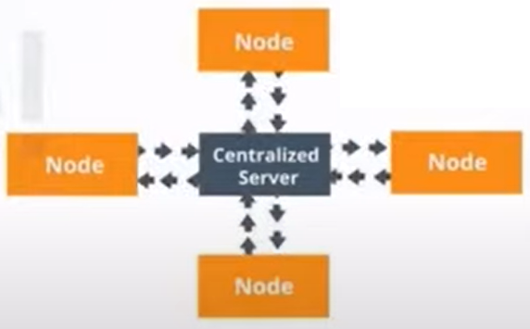
Pull CM
Pull configuration is one whereby clients/nodes periodically pull configuration from puppet master.
Ref: https://www.youtube.com/watch?v=2m3wfNR0lJ0

Slide 18
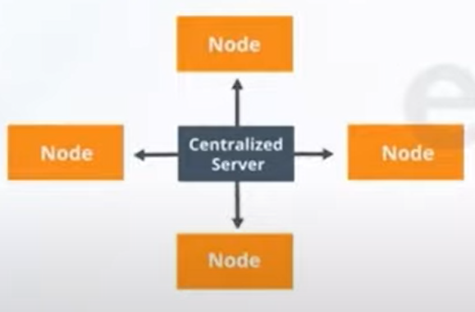
Push CM
Push configuration is one whereby centralized server pushes configuration to clients/nodes.
Ref: https://www.youtube.com/watch?v=2m3wfNR0lJ0

Slide 19
Push and Pull Based Grouping
 | Pull Configuration | Push Configuration
Configuration Management Tool | Puppet | Ansible
 | Chef | SaltStack
Ref: https://www.youtube.com/watch?v=2m3wfNR0lJ0

Slide 20
Puppet in CM
Puppet is one of the popular configuration management tools. It can be used for:
Server deployment
Server configuration
Server Management
Ref: https://www.youtube.com/watch?v=2m3wfNR0lJ0

Slide 21
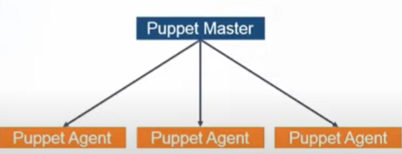
Puppet in CM
Puppet is using pull configuration. Puppet agent periodically pull configuration from Puppet Master. Alternatively, manually run puppet agent –t on client pull configuration from puppet master immediately. Puppet master has all the configurations.
Ref: https://www.youtube.com/watch?v=2m3wfNR0lJ0

Slide 22
Desired Stage Management
There are many benefits for implementing a declarative configuration tool like Puppet into IT environment. Most notably are consistency and automation:
Consistency
Troubleshooting problems with servers is a time-consuming and manually intensive process. Without configuration management, you are unable to make assumptions about your infrastructure. However, when configuration management tool is used, the desired state can be ensured.
Automation
When managing a set of servers in IT infrastructure, these servers are to be kept in a certain state. if there are 100 or 1,000 servers and in mixed environment, or the infrastructure will be scaled in the future, manually configuration can be time consuming and tedious. Appropriate tool such as Puppet can save time and money, to scale effectively, and to do so securely.
Ref: https://puppet.com/docs/puppet/6/puppet_overview.html#why_use_puppet

Slide 23
Desired Stage Management
Automation
When managing a set of servers in IT infrastructure, these servers are to be kept in a certain state. if there are 100 or 1,000 servers and in mixed environment, or the infrastructure will be scaled in the future, manually configuration can be time consuming and tedious. Appropriate tool such as Puppet can save time and money, to scale effectively, and to do so securely.
Ref: https://puppet.com/docs/puppet/6/puppet_overview.html#why_use_puppet

Slide 24
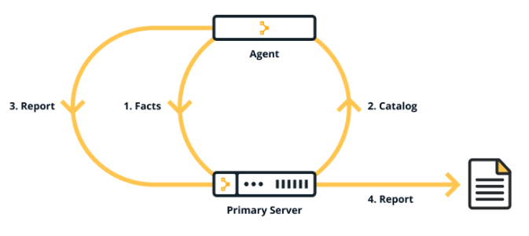
Puppet Catalog
A catalog describes the desired state for each resource that Puppet manages on a node. Puppet Master typically compiles a catalog from manifests of Puppet code.
Ref: https://puppet.com/docs/pe/2021.2/static_catalogs.html

Slide 25
Puppet Facter
Facter is Puppet's system inventory tool. Facter discovers facts intrinsic to a node (such as its hostname, network interfaces and operating system, timezone etc.).Facter has a large number of built-in facts.
Facter cross-platform system profiling library. It discovers and reports per-node facts, which are available in Puppet manifests as variables. facter is a tool that holds the environment level variables, similar to env variable of Bash or Linux.
In agent/master Puppet arrangements, agent nodes send their facts to the master, and the master compiles the catalog using these facts. Facts are always generated prior to the agent run.
Ref: Getting Started with Puppet 2.0.1
Ref: https://puppet.com/docs/puppet/6/puppet_overview.html

Slide 26
Puppet Facts
Puppet collects system information, called facts. Each puppet resource has its own facts. Custom facts can be built.
Facts are information collected about a node and reported to the Puppet master on each run. Facts are collections of system information such as timezone, IP address, hostname, cpu temperature, uptime, disk space, installed applications, running daemons or services, and many other things collected by facter each time the Puppet agent runs.
Facts can be used to generate inventory reports or they can be used by Puppet to make decisions about how to configure a given node.
Ref: https://puppet.com/docs/puppet/6/puppet_overview.html

Slide 27
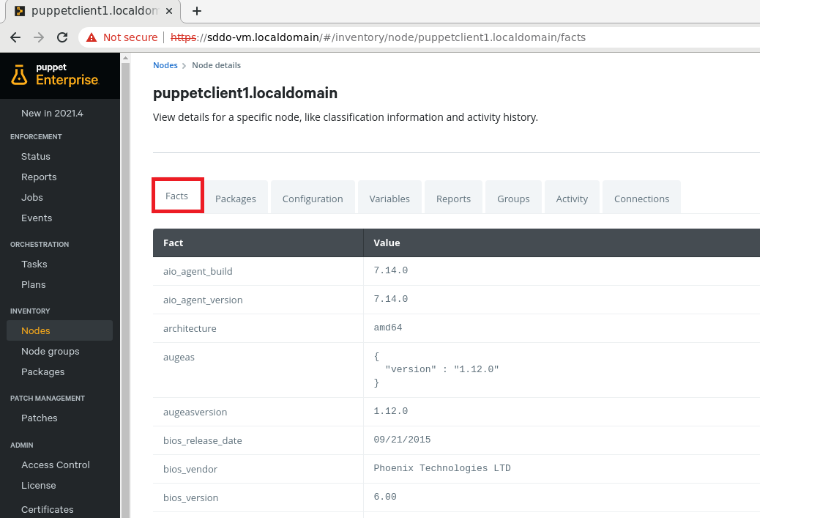
Puppet Enterprise GUI - Facts

Slide 28
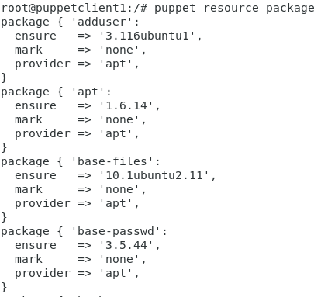
Puppet Resource - Package
Puppet automatically guess the packaging format based on the platform that the command is run. It can be overrided using the provider parameter. Provider defines what is required in order to function.
To list installed packages:
$ puppet resource package
Ref: https://puppet.com/docs/puppet/5.5/types/package.html

Slide 29
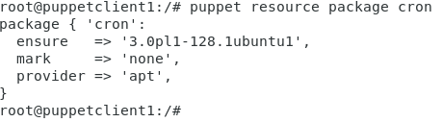
Puppet Resource - Package
To list a particular installed packages:
$ puppet resource package <package name>
For example:
Ref: https://puppet.com/docs/puppet/5.5/types/package.html

Slide 30
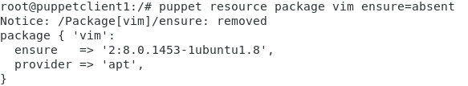
Puppet Resource - Package
Ensure a package is not installed:
$ puppet resource package <package name> ensure=absent
Ref: https://puppet.com/docs/puppet/5.5/types/package.html

Slide 31
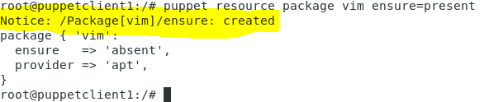
Puppet Resource - Package
Ensure a package is installed:
$ puppet resource package <package name> ensure=present
Ref: https://puppet.com/docs/puppet/5.5/types/package.html

Slide 32
Puppet Enterprise GUI - Packages
Package data collection is disabled by default, so the Packages page in the console initially appears blank.

Slide 33
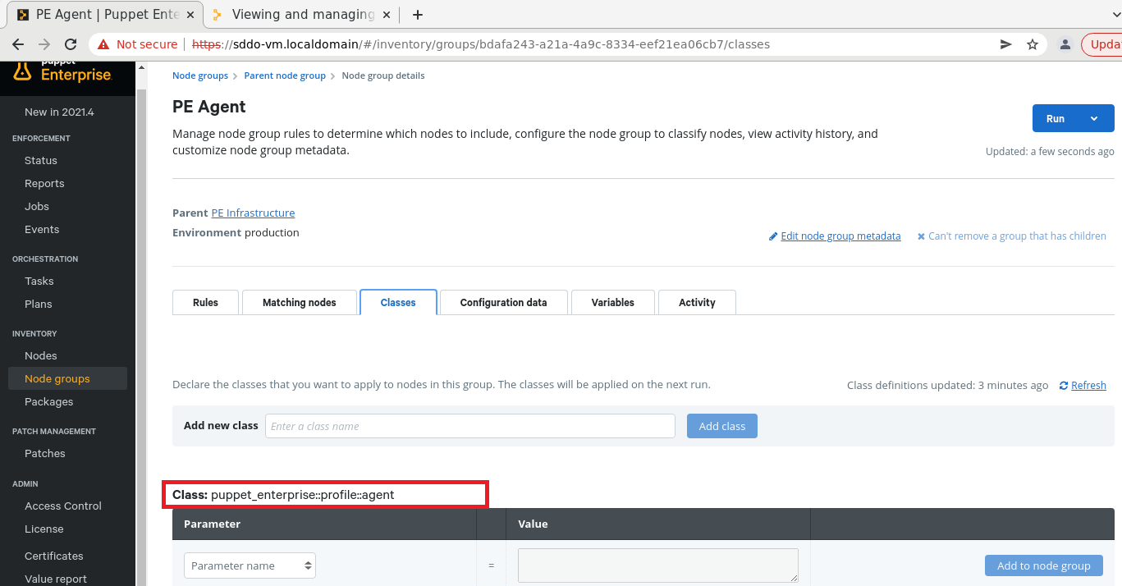
Puppet Enterprise GUI - Packages
To enable packages collection, need to set package_inventory_enabled to true as shown below:

Slide 34
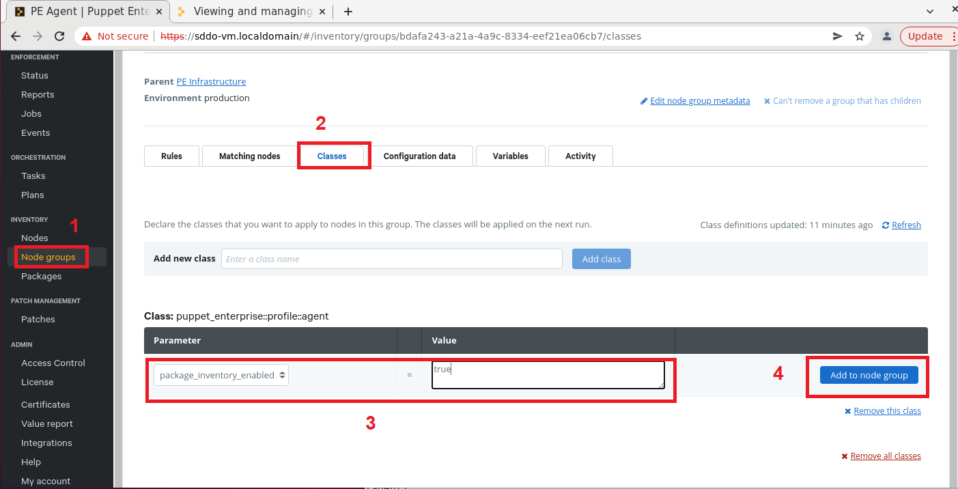
Puppet Enterprise GUI - Packages

Slide 35
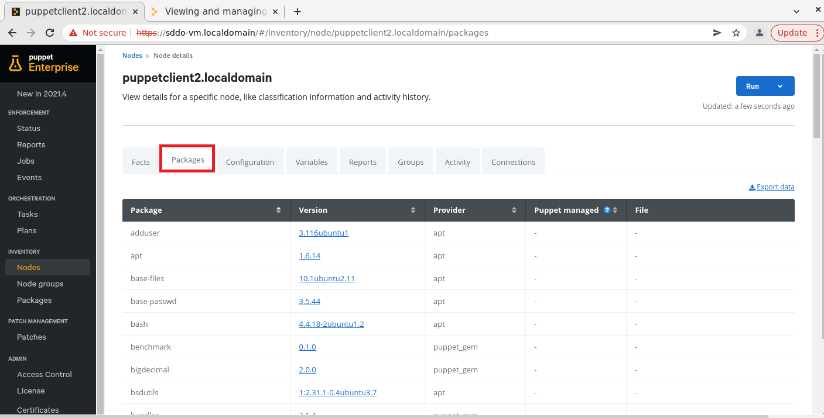
Puppet Enterprise GUI - Packages

Slide 36
Reference
https://www.vmware.com/topics/glossary/content/configuration-management.html
https://searchsoftwarequality.techtarget.com/answer/What-is-the-DevOps-role-for-operations-people
https://www.youtube.com/watch?v=2m3wfNR0lJ0
https://puppet.com/docs/puppet/6/puppet_overview.html#why_use_puppet
Getting Started with Puppet 2.0.1 (By Puppet)

Slide 37
Thank you

